Slide 1
Answer these on the top of your notes for today.
3 effects of the War of 1812
2 ways that territorial expansion transformed American society.
1 aspect of the Northwest Ordinance

Slide 2
What region of the United States is the most populated?

Slide 3
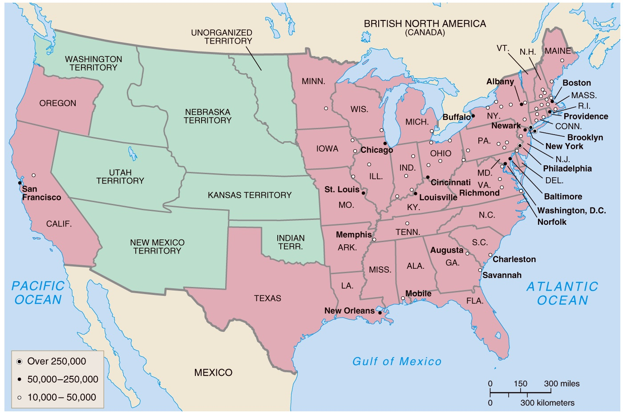
City growth
2. How has population been redistributed through the United States?
3. What region do you think is the most economically powerful?
Westward expansion
Growth of cities and states by 1850

Slide 4
4. What geographic feature is preventing population from expanding further West?

Slide 5
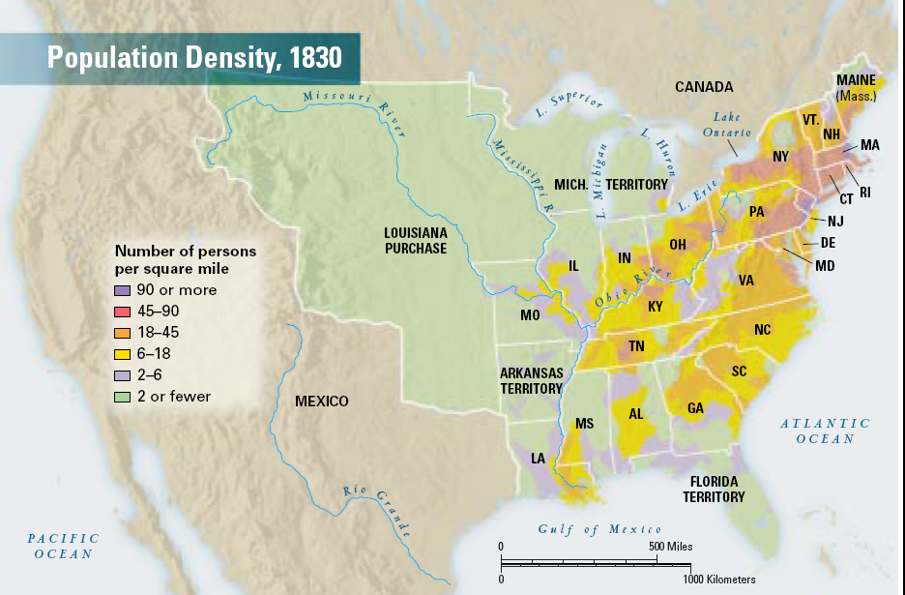
5. The Appalachian Mountains are now more densely populated. What resources are being mined in the mountains?
6. Why are these resources important to industrialization?

Slide 6
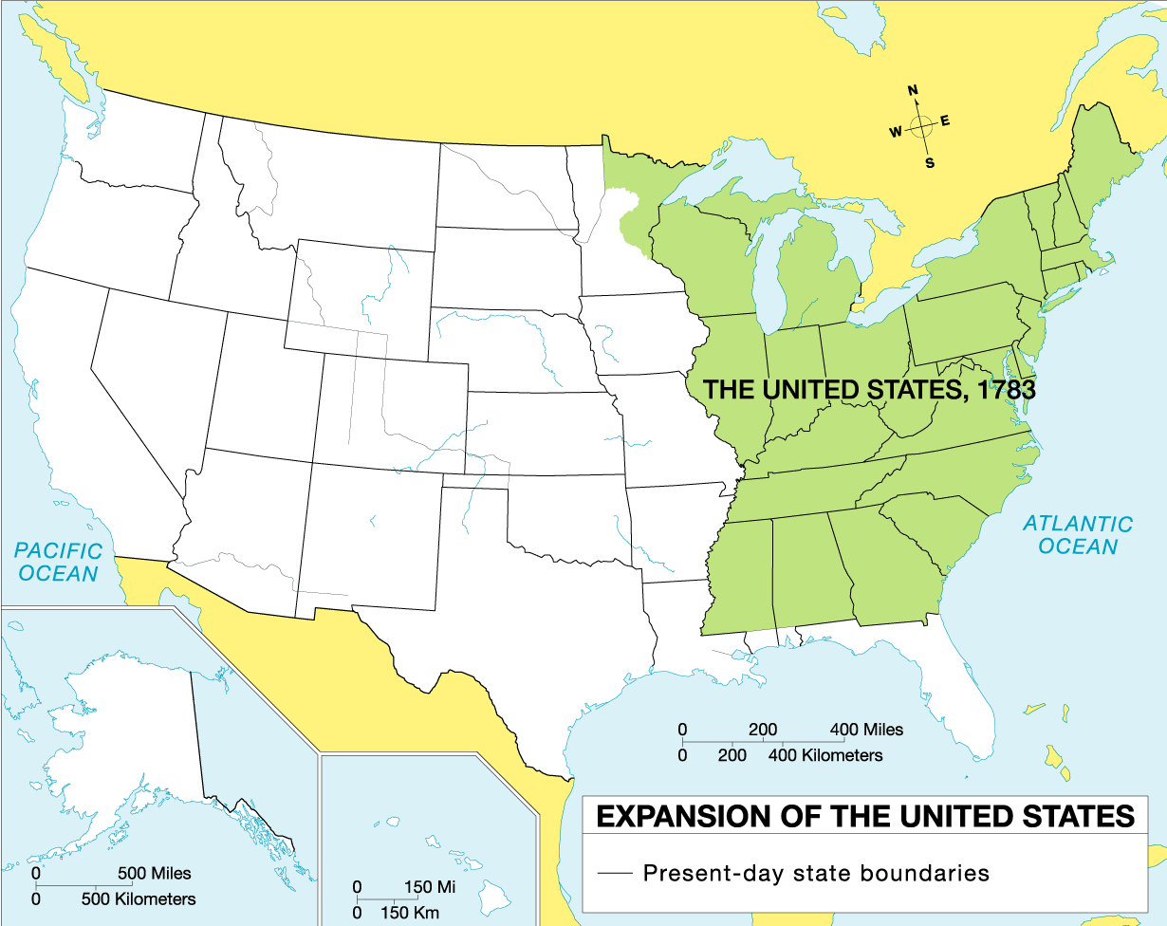
Expansion of the United States
Map 6 of 45
7. Did the US fight a war? Name of war and country fought?
8. Did the US buy land? From whom and how much?
9. President responsible
10. Name of treaty and date.

Slide 7
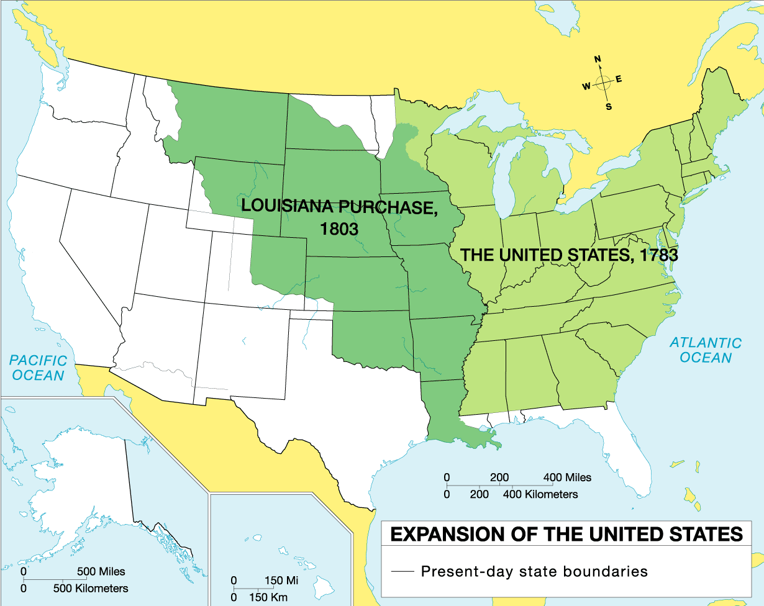
Expansion of the United States with Louisiana Purchase 1803
Map 7 of 45
Did the US fight a war? Name of war and country fought?
Did the US buy land? From whom and how much?
President responsible
Name of treaty and date.

Slide 8
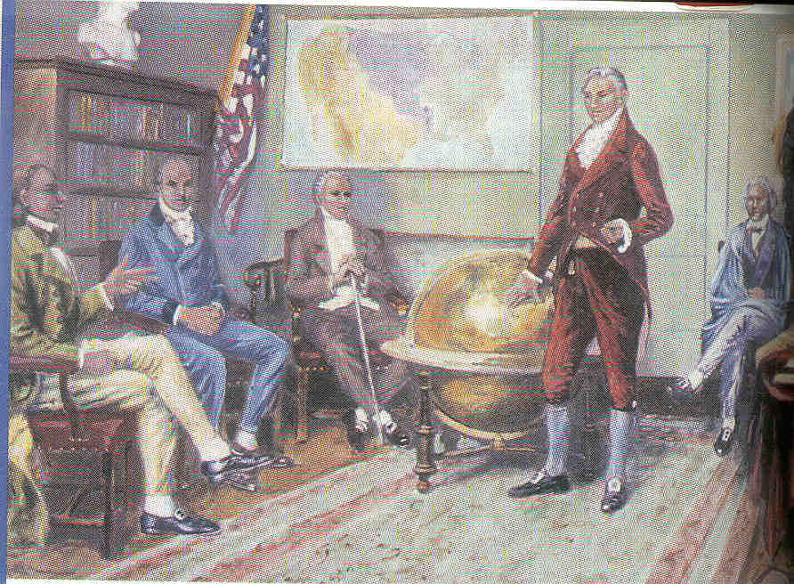
MONROE DOCTRINE
monroe doctrine
He stated, "by the free and independent condition which they have assumed and maintain, are henceforth not to be considered as subjects for future colonization by any European Power."

Slide 9
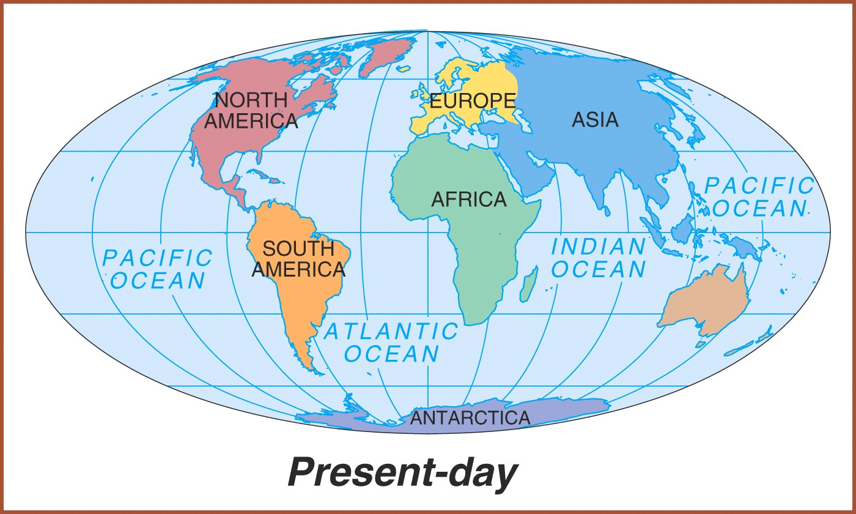
Western Hemisphere or the Americas.

Slide 10
Standard 7
Students will explain the process of economic growth, its regional and national impact in the first half of the 19th century, and the different responses to it.

Slide 11
Simulation

Slide 12
A

Slide 13

Industrial Revolution
It was an ongoing effort over many decades to increase production by using machines powered by sources other than humans or animals.

Slide 14
INVENTIONS!!!

Slide 15
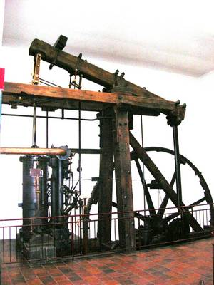
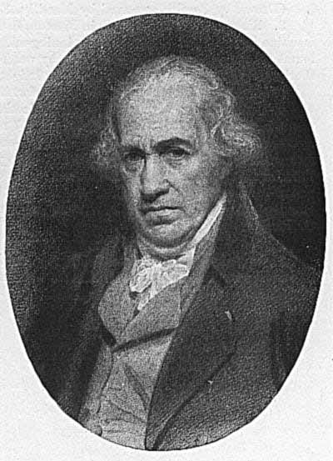
James Watt
Steam Engine (1769)→ Used coal rather than water. Powered machines like the cotton mills → it will lead to the factory system → allowed factories to be built wherever and not just near a water source

Slide 16
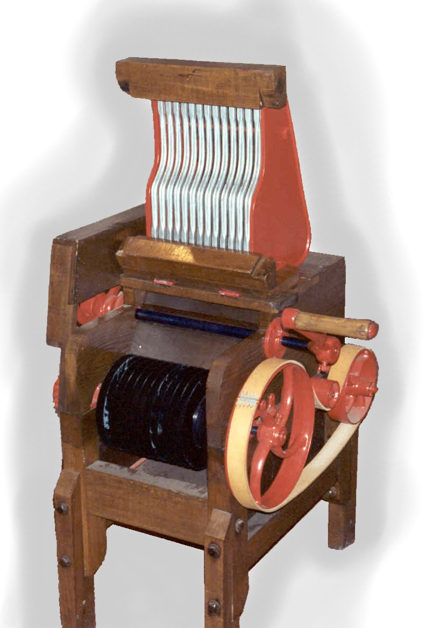
The Cotton Gin
It is a machine that separates the seeds from raw cotton fibers.
It was invented by Eli Whitney.
Gin is short for engine.

Slide 17
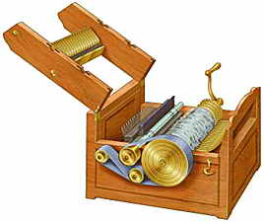

Eli Whitney
Cotton Gin (1793) → made cotton plantations increase their use of slave labor

Slide 18
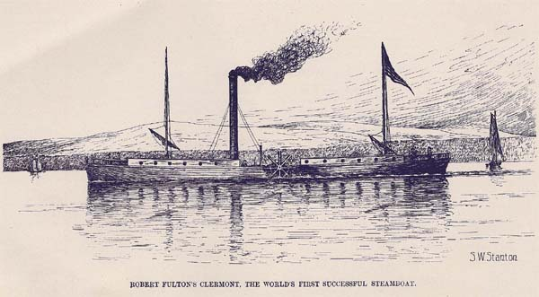
Steamboat
In 1807, Robert Fulton designed a steam engine for a steamboat that could move against the current of a river or against the wind.
The steamboat created more opportunities for trade and transportation on rivers.

Slide 19
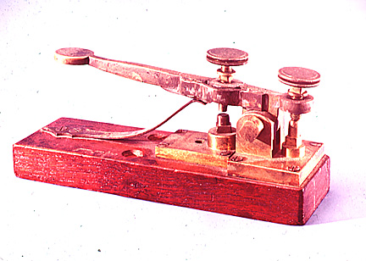
The Telegraph
In 1837, the telegraph was invented by Samuel Morse.
With the telegraph, it took only seconds to communicate with another city.
The invention of the steamboat and telegraph brought the people of the nation closer to each other.

Slide 20
CHECK FOR UNDERSTANDING

Slide 21
1.) The cotton gin was an important invention because
A) it inadvertently led to the spread of slavery.
B) it made cotton much easier for slaves to pick.
C) it caused people to stop needing so much cotton.
D) it angered northern farmers who could afford it.

Slide 22
2.) Which of the following is famous for creating the first steam engine?
  Samuel Morse
  Robert Fulton
  James Watts
  Eli Whitney

Slide 23
3) The creation of the steam engine had which of the following effects?
  Decline in transportation due to the lack fuel.
  Allowed factories to be built wherever and not just near a water source.
  Increase of people moving to more rural areas due to a lack of job opportunities.
  Decreased the use of slave labor

Slide 24
4) This invention created more opportunities for trade and transportation on rivers.
  Steamboat
  Railroad
  Turnpike
  Telegraph

Slide 25
5) Which of the following was a consequence of the rise of factories and innovation in farming technology?
A. People immigrating to Europe to seek more farmland.
B. The creation of cities and people moving into cities to find jobs.
C. Decrease in cotton production.
D. The temperance movement.

Slide 26
Pitch Your Own Invention
Your task is to pitch a new invention to Invent America, one the largest invention firms in the US
  Think about the inventions that make your life easier (cars, cell phones, microwaves, etc.)
  What is something that you would invent to make people’s lives easier? How would this invention affect society?
  Think about transportation, technology, school, and beyond!
Pitch must be 2 paragraphs or more and include an illustration
Be creative and persuasive!!!

