Slide 1
Essential Question:
What are the similarities & differences among the Southern, New England, & Middle colonies?
Warm-Up Question:
How does geography impact the development of colonies?
Why do people today move to Mabelton, Georgia? What attracts people to move here?
Notes:
Lesson plan for August 14, 2009: Warm-up question, Chesapeake Notes & New England, Closure Activity

Slide 2
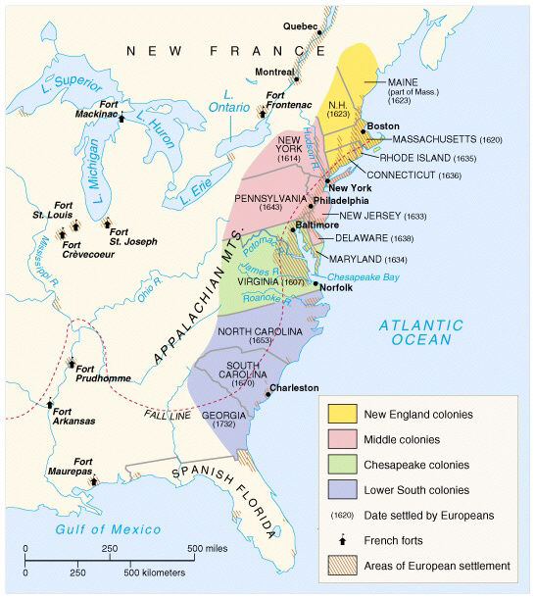
The Virginia Colony
Notes:
Explain Virginia’s development; include the Virginia Company, tobacco cultivation, relationships with Native Americans such as Powhatan, development of the House of Burgesses, Bacon’s Rebellion, and the development of slavery.

Slide 3
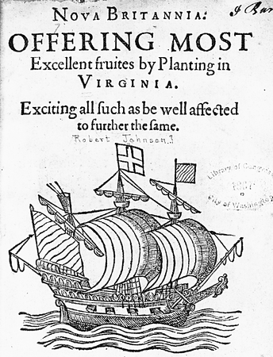
What does this advertisement reveal about the Jamestown colony?
Notes:
For all slides with GREEN backgrounds: Have students interpret the images and make assumptions about the colonial region. Spiral questions from lower-order thinking (what do you see?) to higher-order thinking (what can we infer about this colonial region?, etc.)

Slide 4
Settling the British Colonies
Unlike the Spanish & French, the British colonies were not funded or strictly controlled by the king:
Joint-stock companies were formed by investors who hoped to profit off new colonies
Once a charter was gained from the king, the company could maintain a colony in America

Slide 5
Jamestown, Virginia
In 1606, the Virginia Company was formed by investors hoping to find gold in the New World
In 1607, Jamestown became the first permanent British colony in America

Slide 6
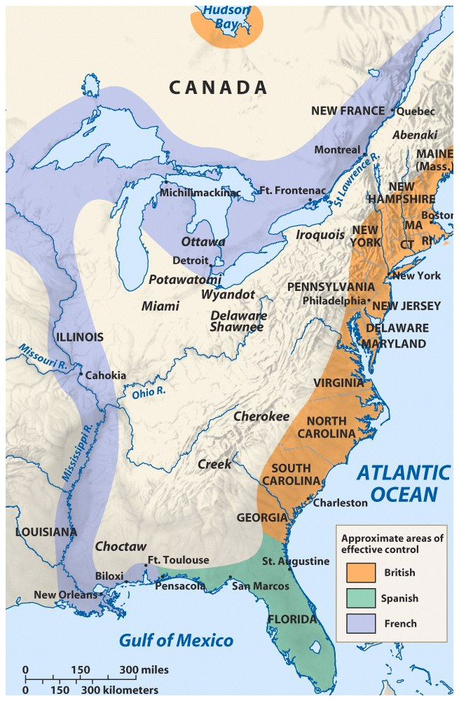
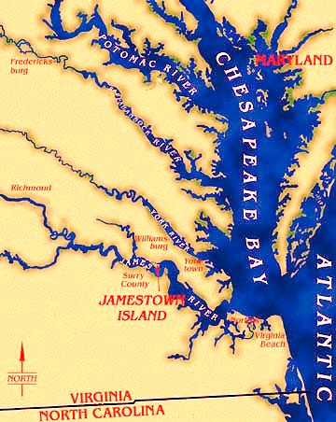
What are the advantages of this location? Disadvantages?

Slide 7
Jamestown: The “Starving Time”
Jamestown struggled to survive:
The location on the Chesapeake was swampy & located in the heart of the Powhatan Indian lands
Colonists expected immediate wealth from gold, failed to plant crops, & faced major starvation
With the brief exception of John Smith, Jamestown lacked leadership to unify the colonists
Notes:
Clash of cultures; settlers had no experience in founding a settlement-they simply did that they knew. This did not work

Slide 8
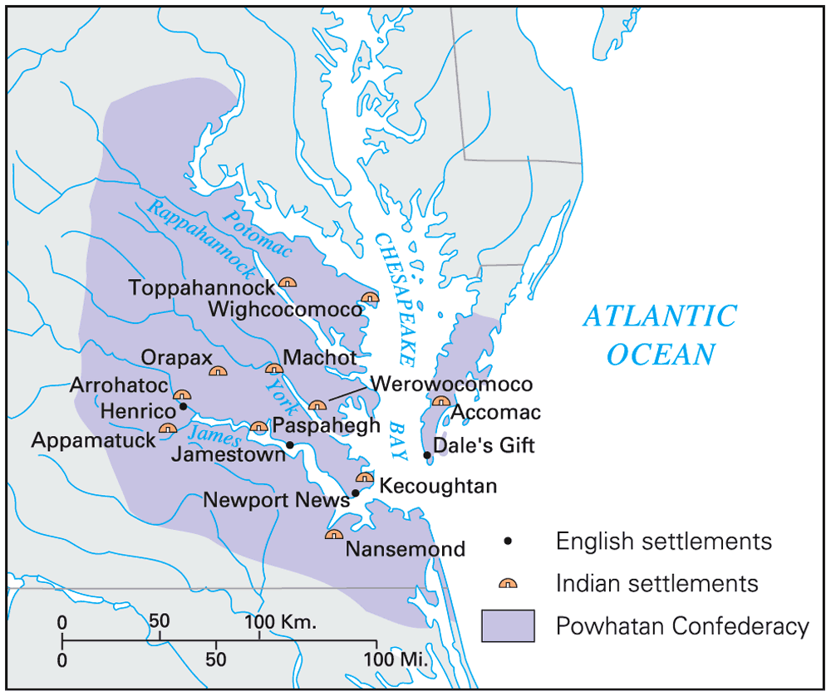
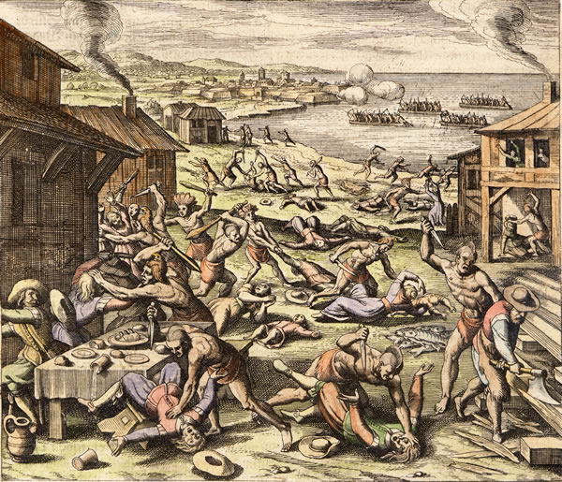
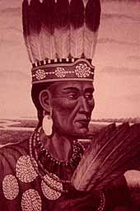
Powhatan Confederacy
The 1622 Powhatan uprising killed 347 Jamestown colonists

Slide 9
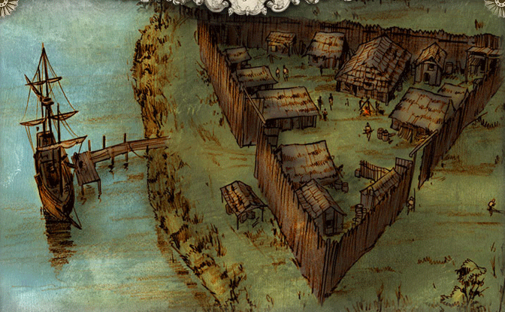
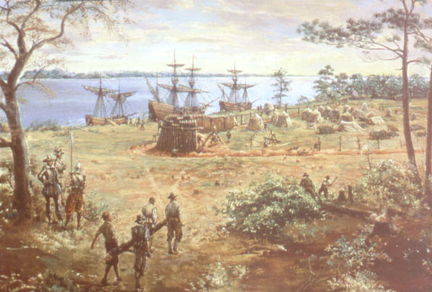
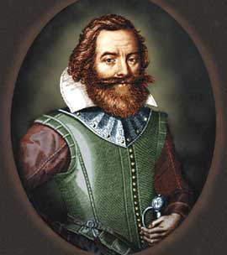
John Smith took control, forced colonists to farm, & negotiated with nearby Powhatan Indians
“He who will not work, will not eat”

Slide 10
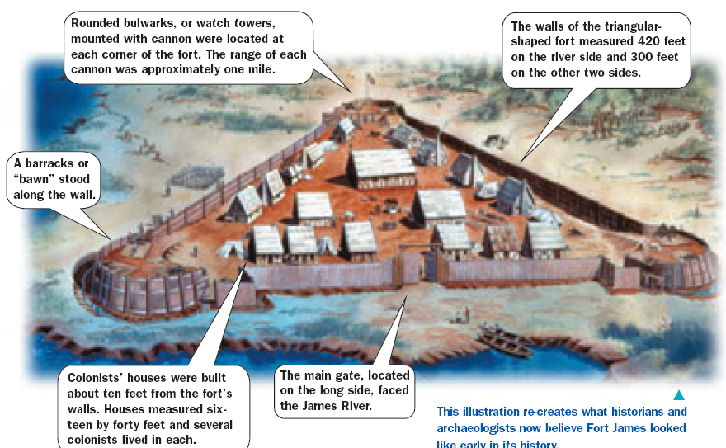
Fort James

Slide 11
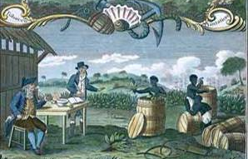
What does this image reveal about Jamestown?
Notes:
For all slides with GREEN backgrounds: Have students interpret the images and make assumptions about the colonial region. Spiral questions from lower-order thinking (what do you see?) to higher-order thinking (what can we infer about this colonial region?, etc.)

Slide 12
Jamestown Survives
The Jamestown colonists hoped to find wealth and they did:
In 1612, John Rolfe experimented with a hybrid form of tobacco
Tobacco forced colonists to expand to find new lands & some were able to build large plantations
Tobacco created a need for field laborers to plant & pick the crop

Slide 13
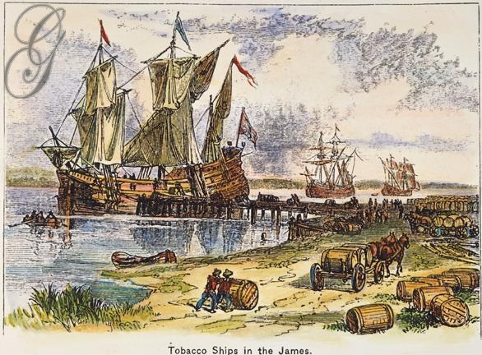
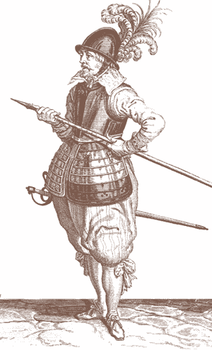
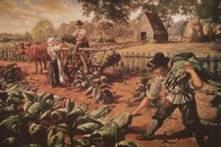
Growing Tobacco in Jamestown
Notes:
explain Virginia's development including the Virginia Company, tobacco cultivation, relationships with Native Americans such as Powhatan, development of the House of Burgesses, Bacon's Rebellion, and the origins of American slavery

Slide 14
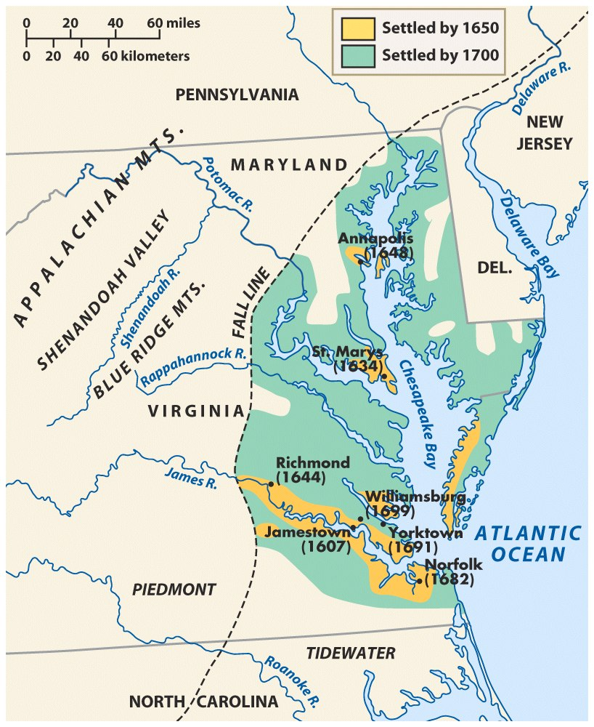
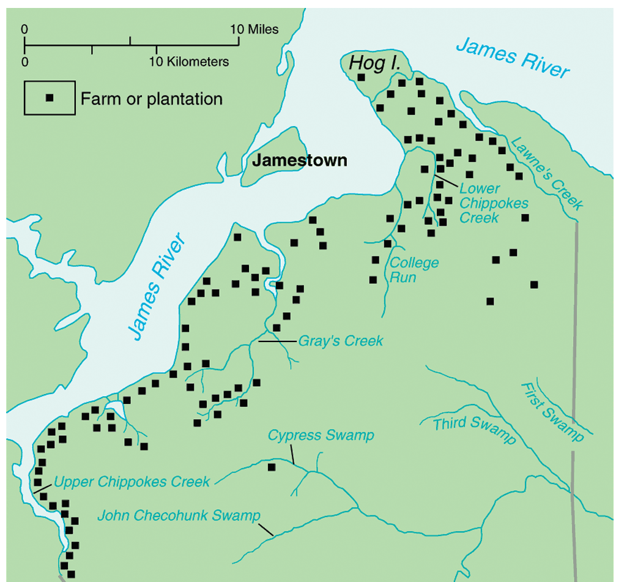
Due to the success of tobacco, Jamestown grew into “Virginia”

Slide 15
Virginia Workers
To meet the demand for field workers, Virginians used:
Indentured servants from England; Typically poor men who agreed to work for a land owner for 4-7 yrs in exchange for travel to America
In 1618, the headright system was created; 50 acres were given to anyone who brought an indentured servant to America
African slaves

Slide 16
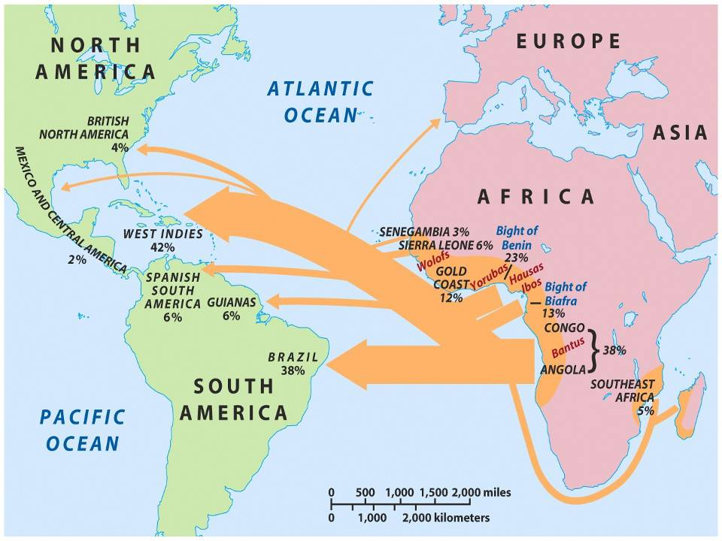
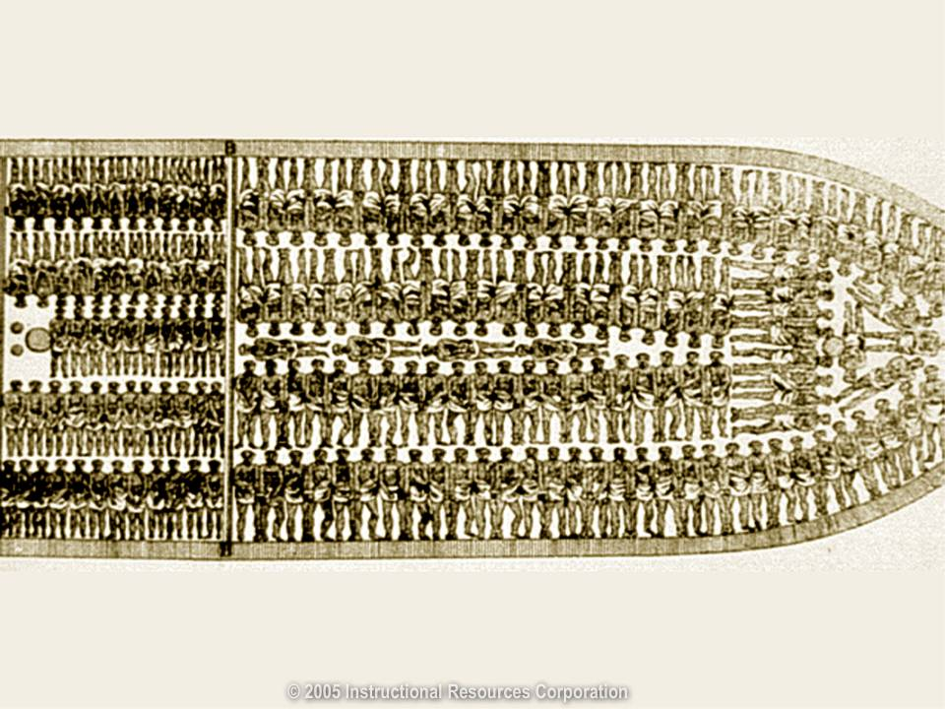
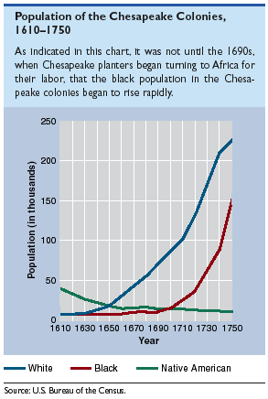
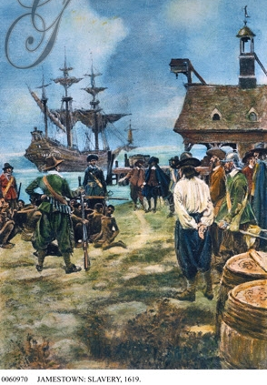
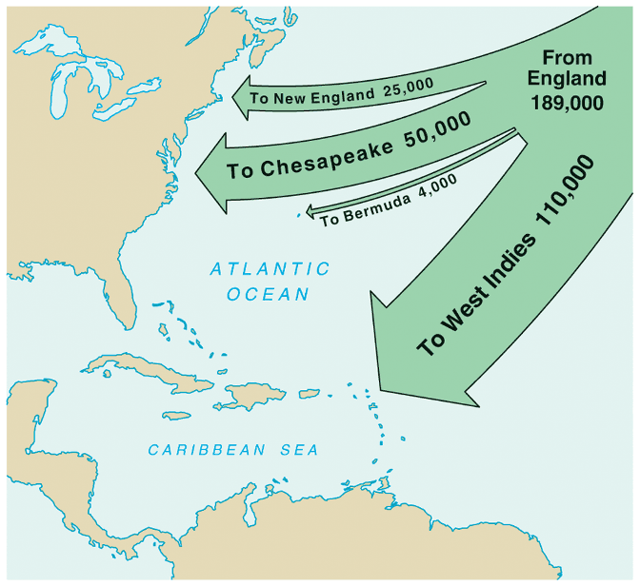
White & Black Migration to VA
Indentured Servants
Trans-Atlantic Slave Trade with Africa
Virginia’s growth was due largely to the headright system & indentured servitude
The first African slaves arrived in Jamestown in 1619

Slide 17
Social Hierarchy in the Chesapeake
There were very few women in Virginia, which made it difficult for colonists to marry or to have families
The owners of tobacco plantations
Small farmers were the largest class; Came as indentured servants; most were very poor
Tobacco was the basis of wealth & cause of social inequalities
Indentured servants were often mistreated
African slaves

Slide 18
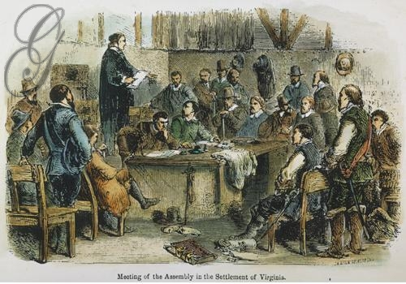
Why are these men gathered here?

Slide 19
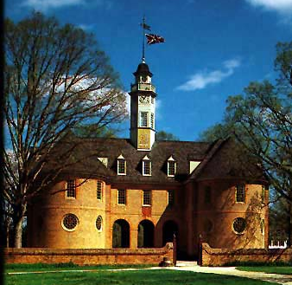
Virginia House of Burgesses
The Virginia colony was a royal colony so it had a governor appointed by the king, but the House of Burgesses made the important decisions regarding taxes & laws
In 1619, Virginia colonists created a legislative assembly to create local laws & taxes
The Virginia House of Burgesses became the 1st legislative assembly in America

Slide 20
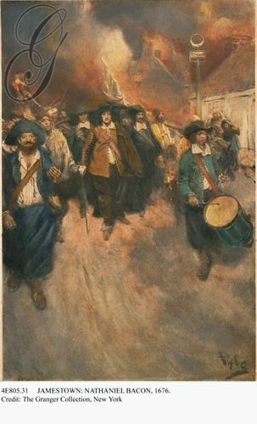
What is going on?

Slide 21
Bacon's Rebellion
Former indentured servants in western VA suffered from poor tobacco prices & Indian attacks
Poor farmers, led by Nathaniel Bacon, blamed VA’s royal governor & started a rebellion
Bacon’s Rebellion proved to rich Virginians that slaves were better than indentured servants because slaves would never ask for land
Notes:
22

Slide 22
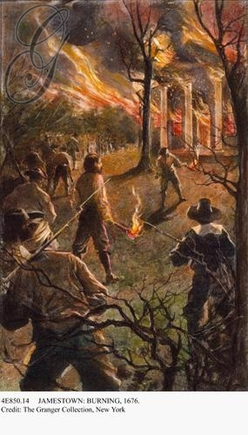
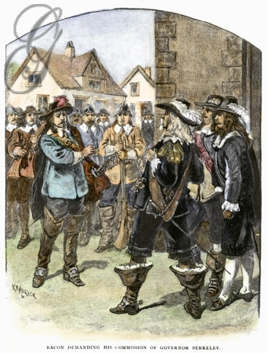
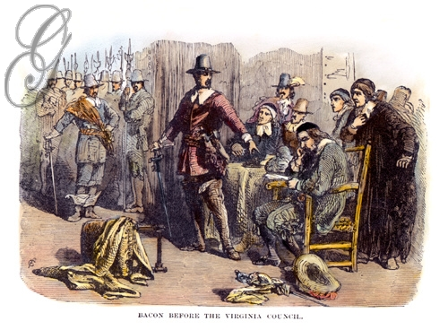
Bacon’s Rebellion

